Slide 1
Data Imbalance
Premalatha T

Slide 2


Slide 3
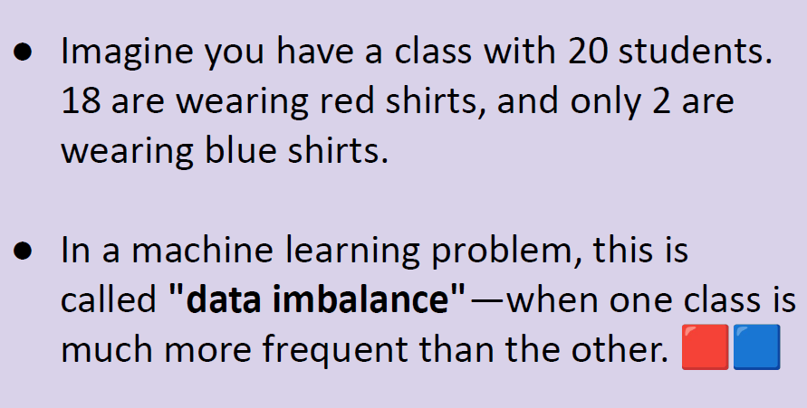

Slide 4
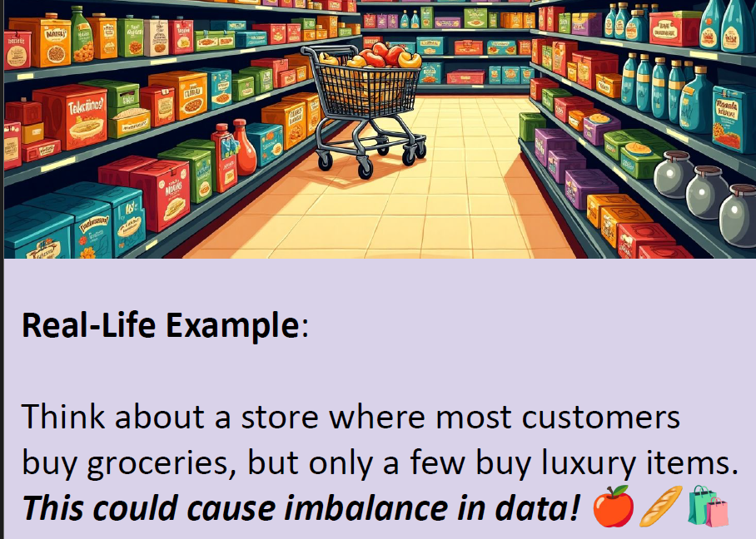

Slide 5
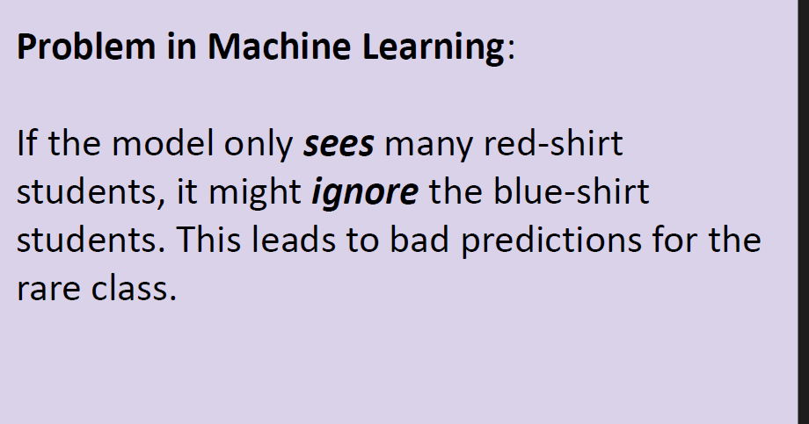

Slide 6
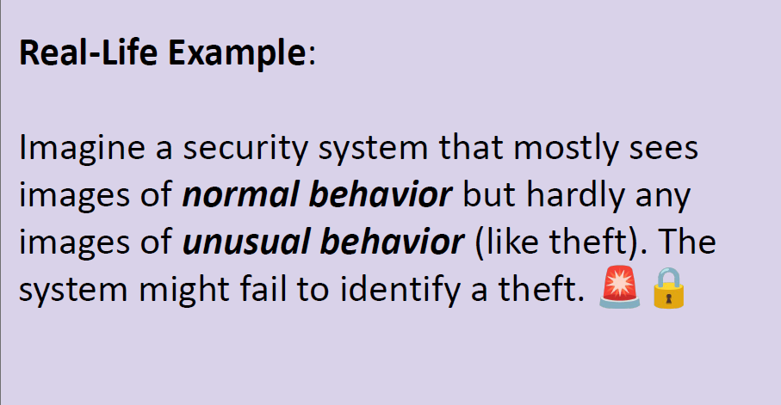

Slide 7
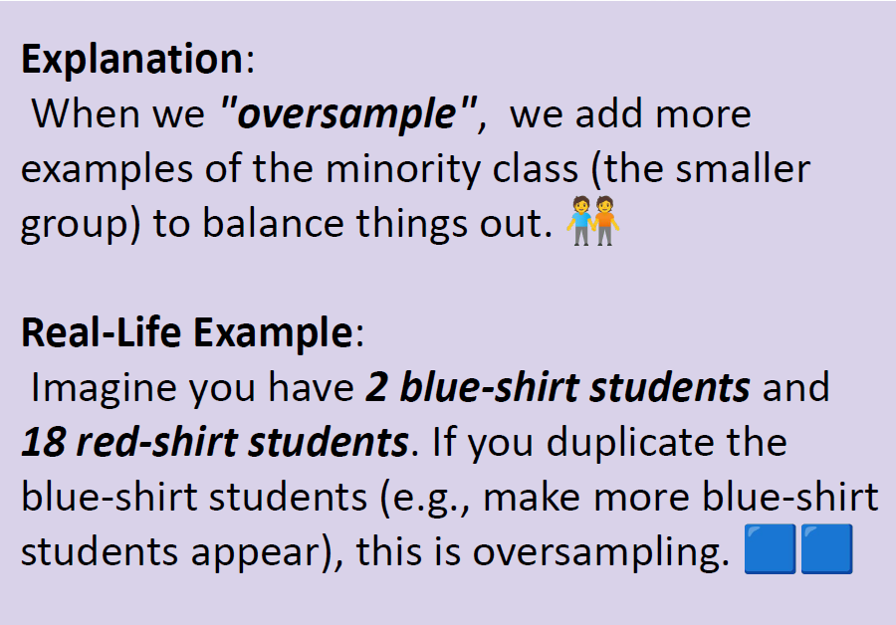

Slide 8
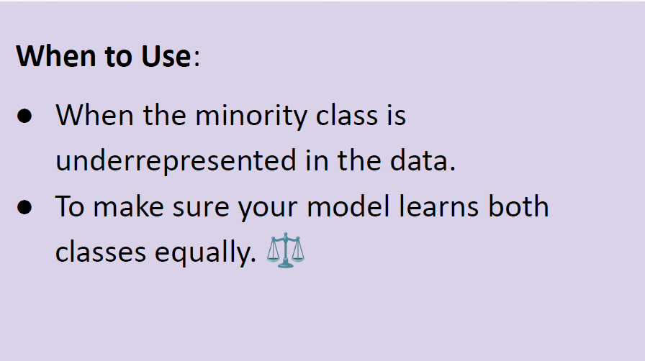

Slide 9
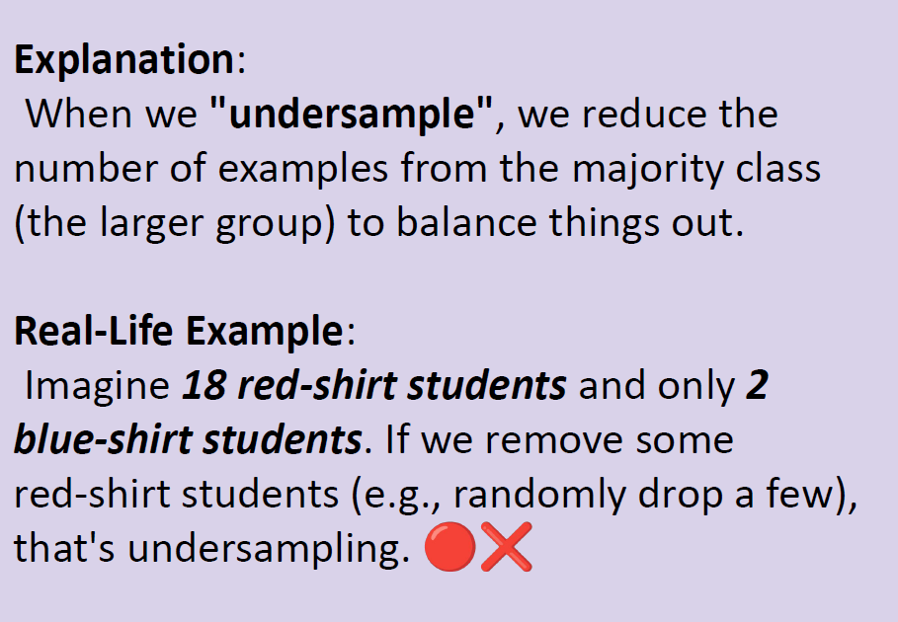

Slide 10
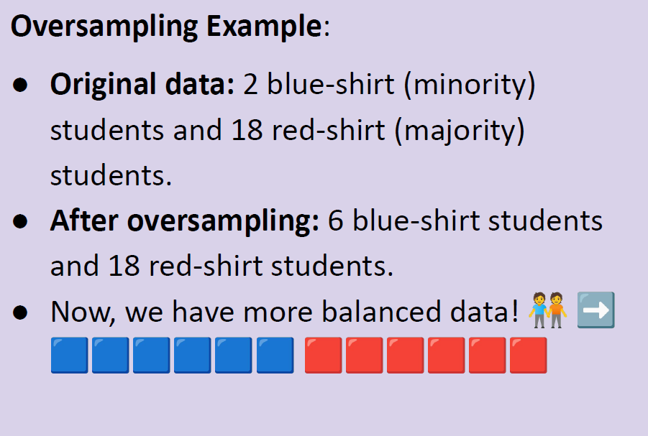

Slide 11
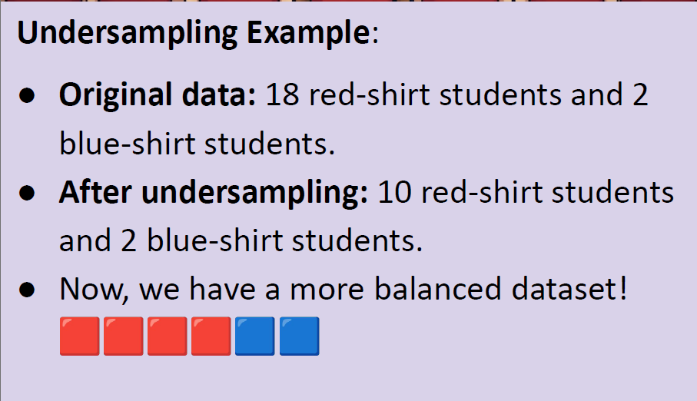

Slide 12
SMOTE (Synthetic Minority Oversampling Technique)
Instead of duplicating minority samples, it creates synthetic (new) data points by interpolating between existing minority samples.
More realistic than simple oversampling.

Slide 13
SMOTE Example (Synthetic Oversampling)
Original Data:
18 red-shirt students
2 blue-shirt students
Problem: Imbalanced dataset (red dominates).
SMOTE Solution:
Instead of just duplicating the 2 blue-shirt students, we create synthetic new blue-shirt students.
These “synthetic students” are not exact copies but are slightly different (like shades of blue shirts).

